Slide 1
ElastiK Nearest Neighbors
An Elasticsearch Plugin to Simplify Online K-Nearest-Neighbors Search
Alex Klibisz - Insight Data Engineering - Boston

Slide 2
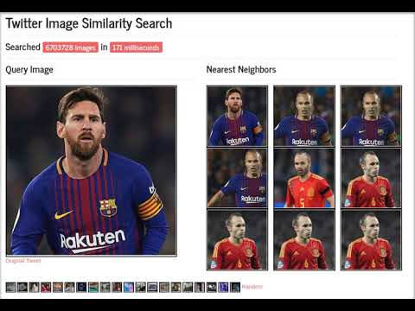

Slide 3

Application: Image Similarity Search Engine
Any Online KNN Application
E.g. similar item recommendation for e-commerce
Feature vectors preserve similarity
Image_1 → ( 0.1, 0.22, … -0.33 )
Image_2 → ( 0.2, 0.33, … -0.44 )
…
Image_n → ( 0.3, 0.44, ... -0.55 )
Convolutional
Neural Network Keras/Tensorflow
Store Vectors
Elasticsearch Cluster
Plugin
Plugin
KNN Search
Image_1 → ( 0.1, 0.22, … -0.33 )
Image_2 → ( 0.2, 0.33, … -0.44 )
…
Image_n → ( 0.3, 0.44, … -0.55 )

Slide 4
KNN on Elasticsearch - Why is it useful?
KNN in offline setting → standard batch infrastructure:
Static corpus of vectors
Batch job computes and caches neighbors
KNN in online setting → complicated infrastructure:
Store and randomly access millions of vectors
Constantly add more items to corpus
Scale horizontally for many concurrent searches
Put the nearest neighbors search on a proven infrastructure: Elasticsearch

Slide 5


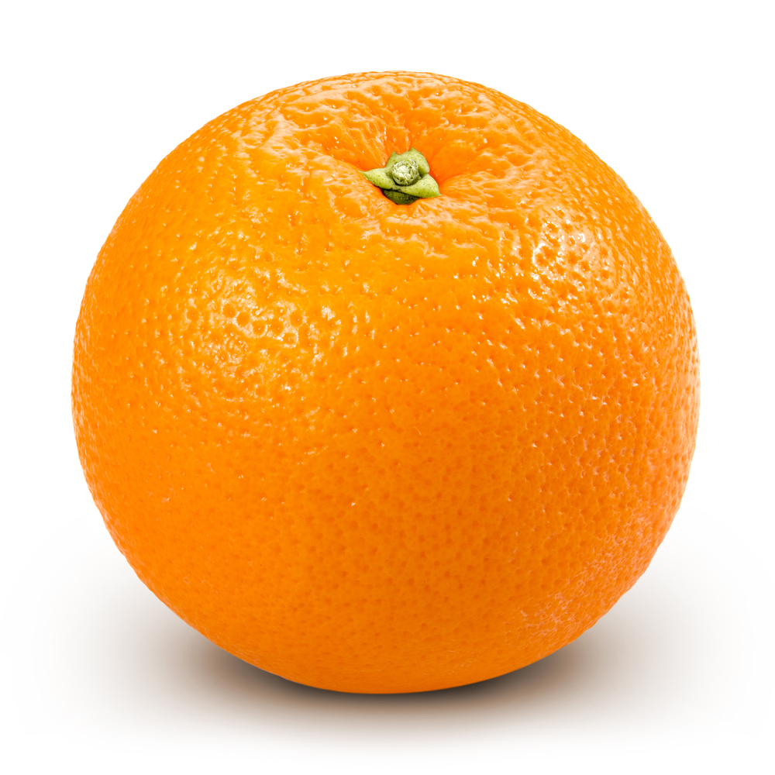
Indexing and searching floating-point vectors?
Locality Sensitive Hashing
Represent vectors as discrete tokens while preserving similarity
2
1
0
(1.6, 1.9)
≈ "Above_line"
(1.8, 1.6)
≈ "Above_line"
(0.5, 0.1)
≈ "Below_line"
0 1 2

Slide 6
Mapping LSH to Elasticsearch
Hash Function 1
Hash Function 2
1 2 3
1 2 3
4 5 6
4 5 6
7 8 9
7 8 9
More hash functions → More likely similar vectors share regions
How to store, query for vectors that share regions?

Slide 7
Mapping LSH to Elasticsearch
Query vector
"hashes": {
"h1": 8
"h2": 31
"h3": 44
}
Candidate vector
"hashes": {
"h1": 8
"h2": 31
"h3": 33
}
"_similarity": 2/3
Hash₁(vec) = 8
Hash₂(vec) = 31
Hash₃(vec) = 44
BooleanQuery
Return vectors with most matching key-value pairs
Search time scales sub-linearly with respect to corpus size
Critical property for online setting

Slide 8
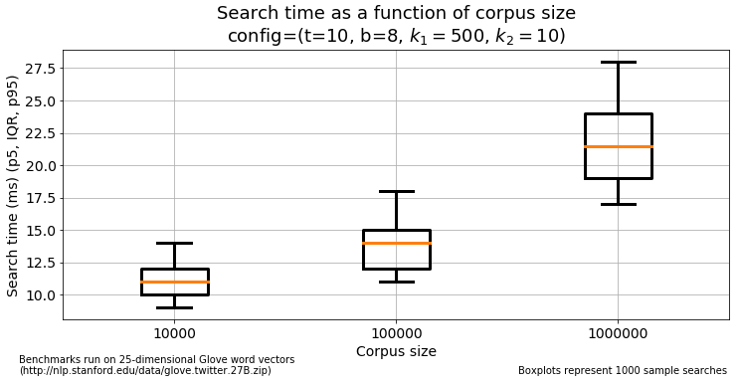
Increase corpus size 100x → increase latency ~2x

Slide 9
More details available
Implementation
Performance (speed and recall)
Image processing pipeline
… saved for Q and A, see supplementary slides

Slide 10
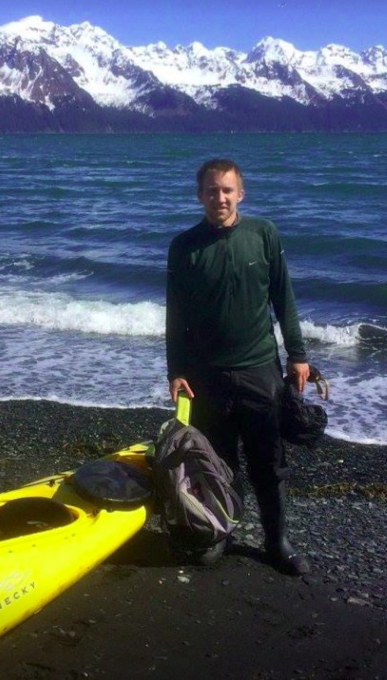
Alex Klibisz
Computer science, University of Tennessee
Enjoy productionizing ML Systems
Enjoy tennis, mountain-biking, traveling, and podcasts
Kayaking in Seward Alaska, May ‘17

Slide 11
Supplementary Material
Nearest Neighbors Plugin
Implementation
Parameters
Benchmark - search latency
Benchmark - recall
Distributed performance
Time complexity
Locality sensitive hashing details
Boolean query details
Full Pipeline
Image processing pipeline

Slide 12
ES-Aknn Implementation
Java with Gradle build system
Operates as a middleware
All logic runs on Elasticsearch nodes
Register endpoint handlers on start
Parse HTTP request parameters and JSON requests when endpoints are hit
Query and store documents using ElasticSearch Java API
Construct and return JSON responses

Slide 13
ES-Aknn Parameters
nb_tables
Number of hash functions applied to each vector
Increasing this increases recall, decreases speed
nb_bits_per_table
Each hash function partitions the space into 2^{nb_bits_per_table} buckets
Changing this affects recall, shouldn’t affect speed
k1
Number of approximate neighbors considered for exact computation
Increasing this increases recall, decreases speed
k2
Number of exact neighbors returned
Changing this has generally negligible effect on speed

Slide 14
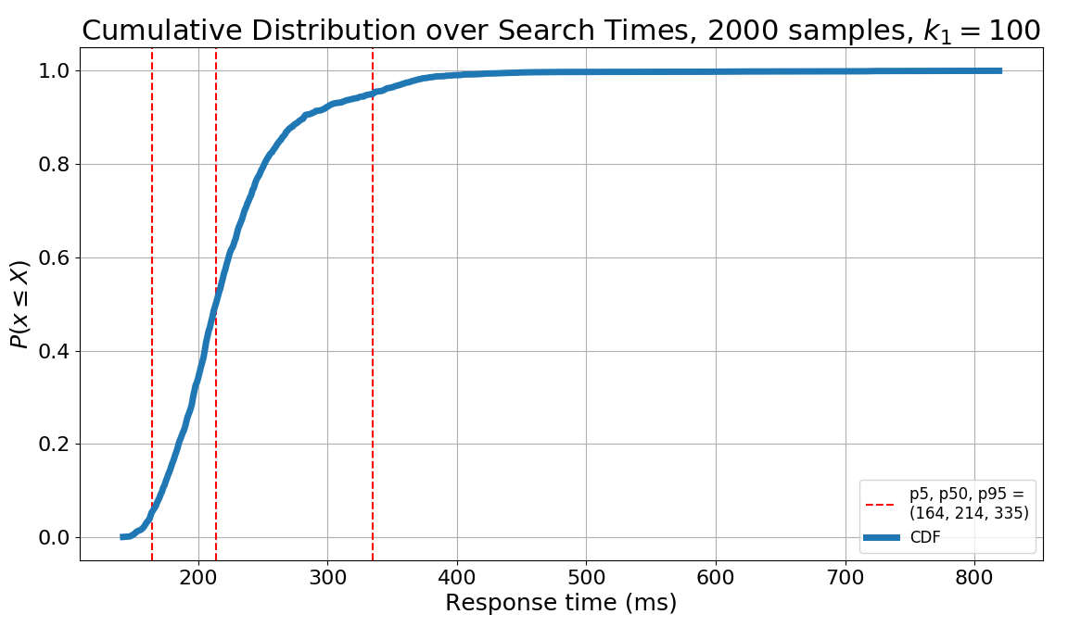
Image Similarity Search Times

Slide 15
Increasing corpus size 100x increases latency ~2x
Notes:
Set ylim 0 to 30

Slide 16
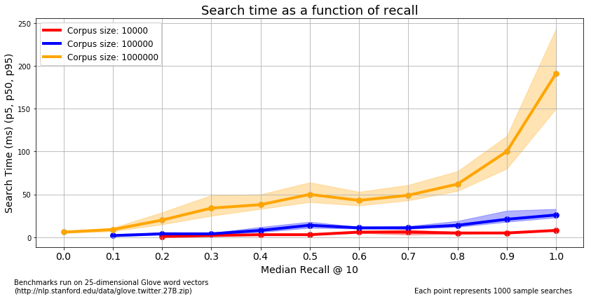
For a corpus with 1 million documents, get median recall 9/10 neighbors with median latency 100 ms.

Slide 17
ES-Aknn Distributed Performance
Setup
4x M5.xLarge (4-core, 16GB, SSD), 5x ES shards
300-dimensional Glove vectors
Indexing new documents
1600 new docs / second using round-robin posts containing 10K vectors
Concurrent searches
100 concurrent queries, LSH with 32 tables, 32 bits
Latency for corpus of 1M vectors: mean ≅ 300 ms, stdv ≅ 80 ms

Slide 18
ES-Aknn Complexity
Search
O(BooleanQuery(N, nb_tables, k1) + (k1 × nb_dimensions) + partial-sort(k1, k2))
Find k1 candidate vectors with matching hashes compute exact similarity find the top k2
≅ O(BooleanQuery(N, nb_tables, k1)) << O(N)
In practice the Lucene BooleanQuery dominates runtime. It’s typically logarithmic or better but depends on configurations.
Indexing
O((nb_tables × nb_bits_per_table × nb_dimensions) + Index(nb_tables))
Hash the floating-point vector via dot products Index as a standard ES document The time spent on hashing vs. indexing depends on the batch size

Slide 19
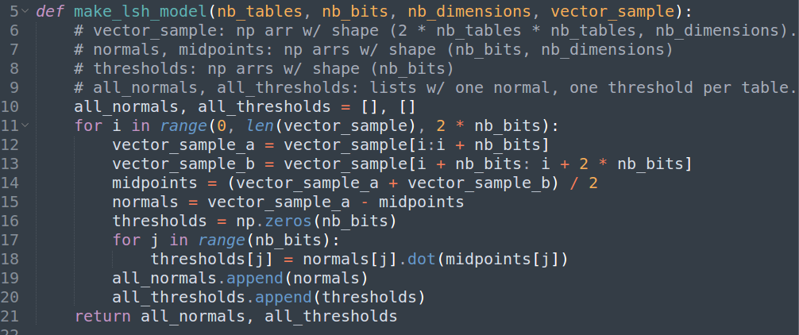
LSH Implementation
Build LSH Model from sample of vectors
Github Gist, Linear Algebra Explanation

Slide 20
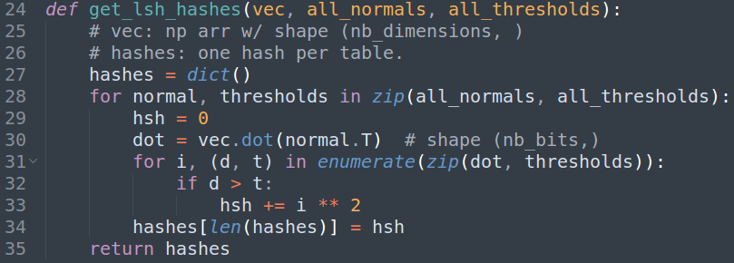
LSH Implementation
Compute the hashes for a vector
Github Gist, Linear Algebra Explanation

Slide 21
LSH Linear Algebra
Given two sample vectors v₁ and v₂, compute an equidistant hyperplane
Hyperplane defined by midpoint m, normal vector n m = (m₁, m₂) = (v₁ + v₂) / 2 n = (n₁, n₂) = v₁ - m
Given a new vector v, compute its hash relative a hyperplane defined by m and n
The hash function should return 1 if the vector is “above” the hyperplane, 0 if the vector is “below” the hyperplane h(v, m, n) = 1[n·v > n·m] (indicator function)
There are nb_tables * nb_bits_per_table such hash functions applied, each using an m an n computed from a random sample pair of vectors.
Applying the hash functions for a single table also yields a binary tree.

Slide 22
ES-Aknn Boolean Query
GET demo/doc/1
{
"_index": "demo",
"_type": "doc",
"_id": "1",
"_source": {
"h0": 10,
"h1": 20,
"h2": 30
}
}
GET demo/doc/_search
{
"query": {
"bool": {
"should": [
{"term": {"h0": 10}},
{"term": {"h1": 20}},
...
]
}
}
}

Slide 23
ES-Aknn Applications
General
K-nearest-neighbors vector storage
Low-latency K-nearest-neighbors search with growing corpus
Specific
Image similarity search (a.k.a reverse image search)
Audio similarity search
Recommendation engines (especially when frequently adding/updating user/item vectors)

Slide 24
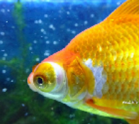
Full Pipeline
Images ingested from Twitter Public Stream
Search requests
ES-Aknn: serve search queries
S3
ES-Aknn: create new LSH model
ES Cluster
ES Cluster
[0.1, 0.2, …, 0.5]
ES Cluster
Kafka Topic
Kafka Topic
ES Plugin: index new vectors
Convnets extract feature vectors
Consumer inserts to ES via plugin

Slide 25
Image Processing Pipeline
Implementation
Kafka as a distributed job queue with 10 EC2 instance workers
Python Kafka consumers computing feature vectors
Keras (MobileNet) pre-trained convnet - use conv_preds layer for output
Consumers pull images from S3 (faster than funneling through Kafka)
Parallelized S3 requests (ThreadPoolExecutor), image preprocessing (Multiprocessing Pool)
Performance
40 images / node / second with K80 GPU ($0.3/hr spot instance)
33 images / node / second with 36-core CPU ($0.6/hr spot instance)

Slide 26
Helpful Resources
LSH lectures by Victor Lavrenko
ES plugin cookiecutter template
ES Ingest-OpenNLP plugin
Presentation about ANNOY by Erik Berhnardsson

